Slide 1
Analyzing the Business Case
Chapter 2

Slide 2
STRATEGIC PLANNING — A FRAMEWORK FOR IT SYSTEMS DEVELOPMENT
Strategic planning starts with a management review called a SWOT analysis.
The letters stand for strengths, weaknesses, opportunities, and threats.
A SWOT analysis usually starts with a broad overview.

Slide 3
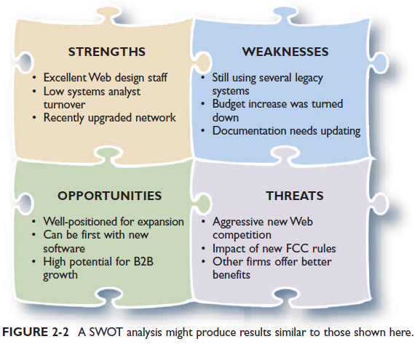
The first step is for top management to respond to questions like these:
What are our strengths, and how can we use them to achieve our business goals?
What are our weaknesses, and how can we reduce or eliminate them?
What are our opportunities, and how do we plan to take advantage of them?
What are our threats, and how can we assess, manage, and respond to the possible risks?

Slide 4
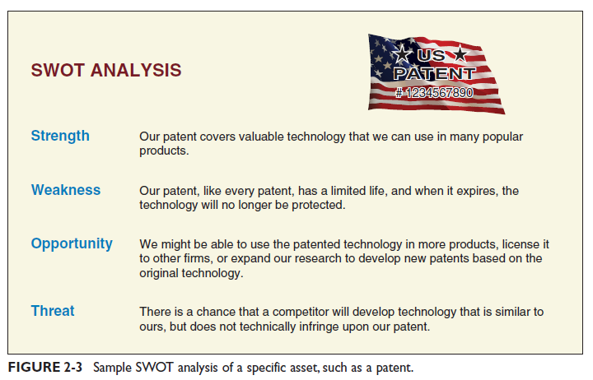
Example
suppose that during a SWOT analysis, a firm studies an important patent that the company owns.

Slide 5
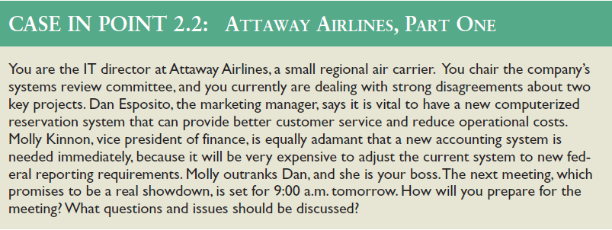
WHAT IS A BUSINESS CASE?
As mentioned earlier, the term business case refers to the reasons, or justification, for a proposal.

Slide 6
A Business Case for Attaway
The business case should answer questions such as the following:
Why are we doing this project?
What is the project about?
How does this solution address key business issues?
How much will it cost and how long will it take?
Will we suffer a productivity loss during the transition?
What is the return on investment and payback period?
What are the risks of doing the project? What are the risks of not doing the project?
How will we measure success?
What alternatives exist?

Slide 7

INFORMATION SYSTEMS PROJECTS
This section discusses reasons for systems projects and the internal and external factors that affect systems projects.

Slide 8
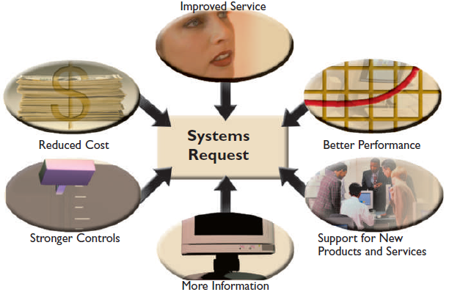
Main Reasons for Systems Projects
The starting point for most projects is called a systems request, which is a formal way of asking for IT support.
A systems request might propose enhancements for an existing system, the correction of problems, the replacement of an older system, or the development of an entirely new information system that is needed to support a company’s current and future business needs.

Slide 9
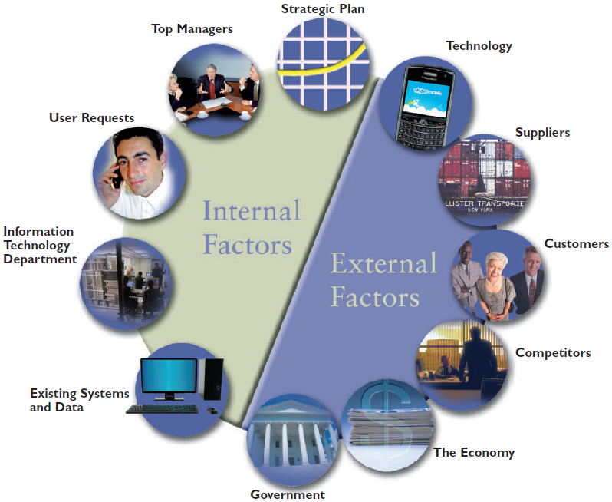
Factors that Affect Systems Projects
Internal and external factors affect every business decision that a company makes, and IT systems projects are no exception.

Slide 10
Internal Factors
STRATEGIC PLAN: A company’s strategic plan sets the overall direction for the firm and has an important impact on IT projects.
TOP MANAGERS: Directives from top managers are a prime source of large-scale systems projects.
USER REQUESTS: As users rely more heavily on information systems to perform their jobs, they are likely to request even more IT services and support.
INFORMATION TECHNOLOGY DEPARTMENT: Many systems project requests come from the IT department. IT staff members often make recommendations based on their knowledge of business operations and technology trends.
EXISTING SYSTEMS AND DATA: Errors or problems in existing systems can trigger requests for systems projects.

Slide 11
External Factors
TECHNOLOGY: Changing technology is a major force affecting business and society in general.
SUPPLIERS With the growth of electronic data interchange (EDI), relationships with suppliers are critically important. For example, an automobile company might require that suppliers code their parts in a certain manner to match the auto company’s inventory control system.
CUSTOMERS Many companies implement customer relationship management (CRM) systems that integrate all customer-related events and transactions, including marketing, sales, and customer service activities.
COMPETITORS Competition drives many information systems decisions. For example, if one cellular telephone provider offers a new type of digital service, other firms must match the plan in order to remain competitive.

Slide 12
THE ECONOMY: In a period of economic expansion, firms need to be ready with scalable systems that can handle additional volume and growth.
GOVERNMENT Federal, state, and local government regulations affect the design of corporate information systems. For example, income tax reporting requirements must be designed into a payroll package. The debate about Internet sales tax issues could profoundly affect e-commerce, as well as traditional retail businesses.

Slide 13
Project Management
As mentioned earlier, business case analysis involves consideration of project reasons, costs, benefits, and risks. At the end of the preliminary investigation, if the project is approved, it can be planned, scheduled, monitored and controlled, and reported upon. Individual analysts or IT staff members often handle small projects, but companies usually designate a project manager to coordinate the overall effort for complex projects.

Slide 14
EVALUATION OF SYSTEMS REQUESTS
In most organizations, the IT department receives more systems requests than it can handle.
Many organizations assign responsibility for evaluating systems requests to a group of key managers and users.
Many companies call this group a systems review committee or a computer resources committee.

Slide 15
Systems Request Forms
Many organizations use a special form for systems requests, similar to the online sample as shown
When a systems request form is received, a systems analyst or IT manager examines it to determine what IT resources are required for the preliminary investigation.

Slide 16
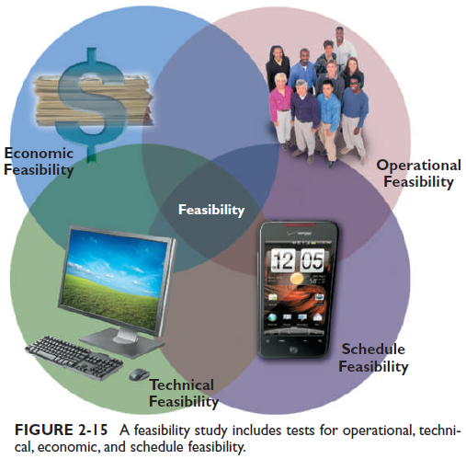
OVERVIEW OF FEASIBILITY
A feasibility study uses four main yardsticks to measure a proposal: operational feasibility, technical feasibility, economic feasibility, and schedule feasibility.
Sometimes a feasibility study is quite simple and can be done in a few hours.

Slide 17
Operational Feasibility
Means that a proposed system will be used effectively after it has been developed. If users have difficulty with a new system, it will not produce the expected benefits.

Slide 18
Technical Feasibility
Technical feasibility refers to the technical resources needed to develop, purchase, install, or operate the system.

Slide 19
Economic Feasibility
Economic feasibility means that the projected benefits of the proposed system outweigh the estimated costs usually considered the total cost of ownership (TCO), which includes ongoing support and maintenance costs, as well as acquisition costs.

Slide 20
Schedule Feasibility
Schedule feasibility means that a project can be implemented in an acceptable time frame.

Slide 21
EVALUATING FEASIBILITY
The first step in evaluating feasibility is to identify and weed out systems requests that are not feasible.
For example, a request would not be feasible if it required hardware or software that the company already had rejected.

Slide 22
SETTING PRIORITIES
After rejecting systems requests that are not feasible, the systems review committee must establish priorities for the remaining items.
The highest priority goes to projects that provide the greatest benefit, at the lowest cost, in the shortest period of time.

Slide 23
Factors that Affect Priority
When assessing a project’s priority, a systems analyst should consider the following:
Will the proposed system reduce costs? Where? When? How? How much?
Will the system increase revenue for the company? Where? When? How? How much?
Will the systems project result in more information or produce better results? How? Are the results measurable?
Will the system serve customers better?
Will the system serve the organization better?
Can the project be implemented in a reasonable time period? How long will the results last?
Are the necessary financial, human, and technical resources available?

Slide 24
Discretionary and Nondiscretionary Projects
Is the project absolutely necessary?
Projects where management has a choice in implementing them are called discretionary projects.
Projects where no choice exists are called nondiscretionary projects.
Creating a new report for a user is an example of a discretionary project; adding a report required by a new federal law is an example of a nondiscretionary project.

Slide 25
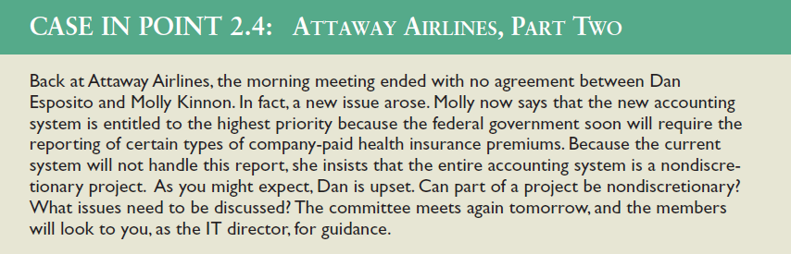

Slide 26
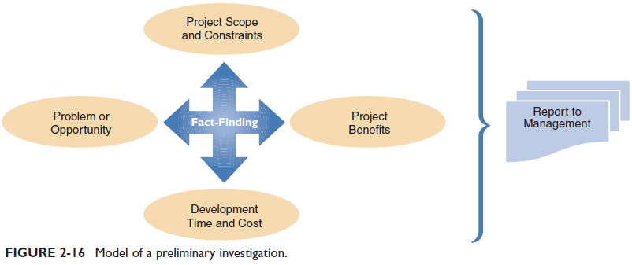
PRELIMINARY INVESTIGATION OVERVIEW
A systems analyst conducts a preliminary investigation to study the systems request and recommend specific action.
After obtaining an authorization to proceed, the analyst interacts with managers and users
analyst gathers facts about the problem, project scope and constraints, project benefits, and estimated development time and costs.
The end product of the preliminary investigation is a report to management.

Slide 27
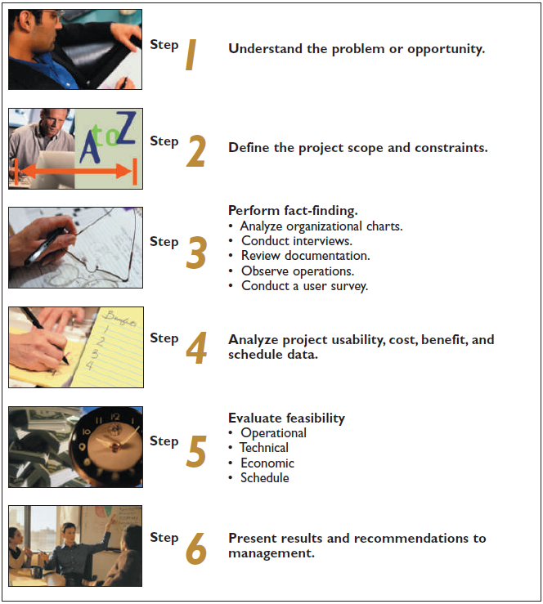
Planning the Preliminary investigation
During a preliminary investigation, a systems analyst typically follows a series of steps.

Slide 28
Chapter 2 Assignment
How does strategic planning influence day-to-day business operations? Why is it important for systems analysts to understand a company’s strategic plan?
What is a SWOT analysis? Prepare a SWOT analysis of your school or your employer.
What is an effective way to assess user requests for additional features and functions?
What are four types of feasibility? Which type focuses on total cost of ownership? Which type is influenced primarily by users?
Describe the six steps in a typical preliminary investigation. Why should an analyst be careful when using the word problem?
What is project scope? What are constraints? Provide an example of a mandatory, external, future constraint. Also provide an example of a discretionary, internal, present constraint.
Identify and briefly describe five common fact-finding methods.
What fact-finding methods are well-suited for complex technical issues? Which might be appropriate for the pursuit of new, cutting-edge features?
What type of tool might a systems analyst use to identify a relationship between two variables? What tool is useful for identifying and prioritizing causes of problems?
What is a fishbone diagram, and why would you use one? Think of a problem you have experienced at school or work, and draw a sample fishbone diagram with at least two levels.

Slide 29
Chapter 2 – Project
Suppose you own a travel agency in a large city. You have many corporate clients, but growth has slowed somewhat. Some long-term employees are getting discouraged, but you feel that there might be a way to make technology work in your favor. Use your imagination and suggest at least one strength, weakness, opportunity, and threat that your business faces.

